Slide 1
Solve Some Queries SQL

Slide 2
Increase income of all employees by 5% in a table.
Find names of employees starting with ‘A’.
Find number of employees working in department ‘ABC’.
Print details of employees whose first-name ends with ‘A’ and contains 6 Alphabets.
Print details of employees whose salary lies between 10000 and 50000.
Fetch only the first name from full name column.
Fetch duplicate records from a table.
Remove duplicates
Create empty table with same structure as some other table.
Fetch common records between 2 tables.

Slide 3
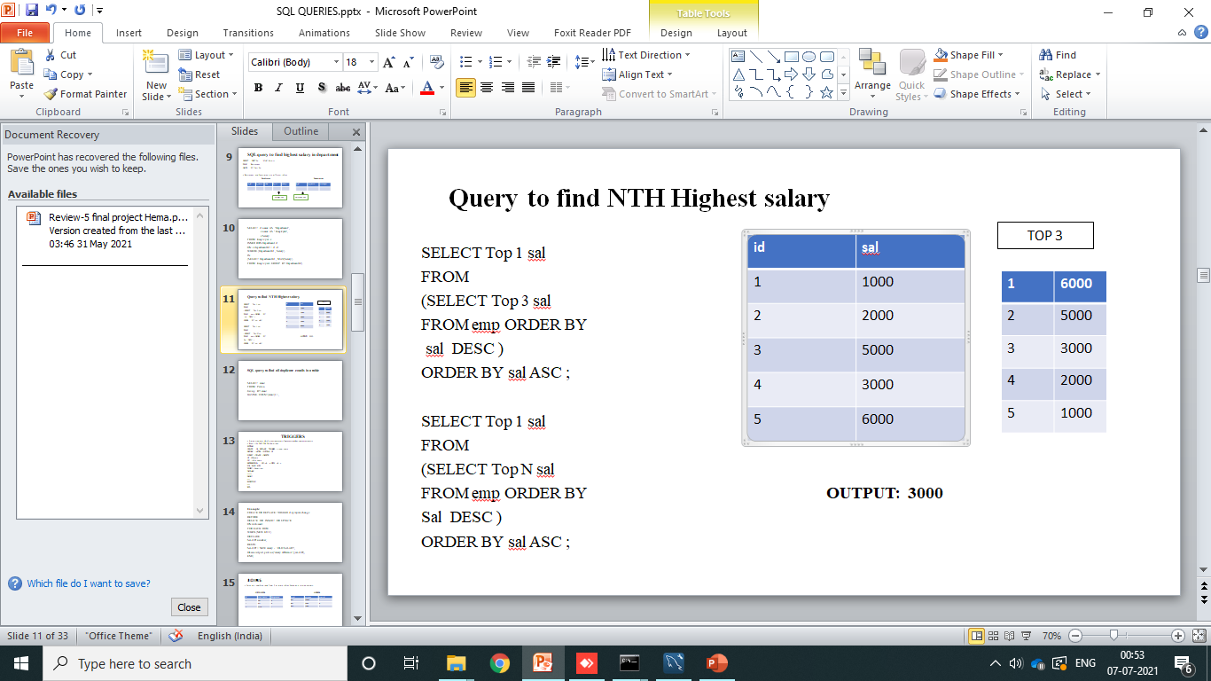
11. Fetch Emp-name in upper case & use alias:
Fetch top N records:
Retrieve empfname and emplname in a single column as “full name”, first name, last name separated with space:
Retrieve emp-position along with total salaries pai for each of them:
Fetch details of empoyees with address as “DELHI(DEL)”:
SQL query to find highest salary in department.
Query to find NTH Highest salary

Slide 4
18. Query that the number of occurrences of each occupation . sort in ascending order and output them in the format:
Occupations
There are total of [ Occupation-count ] [ Occupation ] s.
Output: [ must be ]
There are a total of 2 actors.
There are a total of 15 comedians.
Name | Occupation
Ranveer | Actor
Sharukan | Actor
Vadivel | Comedian

Slide 5
19. SQL query to find all duplicate emails in a table. Employee
20. Find second highest salary .
For : MAX , LIMIT , TOP.
21. How to create table structure from existing table.
22. Query an alphabetically ordered list of all names , immediately followed by the first letter of each profession enclosed in parameters. Occupations
o/p:
Jack (D)
Alan (A)
Charlie (S)
emp-id | emp-name | emp-salary
1 | A | 5000
2 | B | 6000
3 | C | 2000
4 | D | 7000
Name | Occupation
Jack | Doctor
Alan | Actor
Charlie | Singer

Slide 6
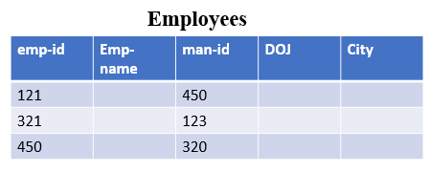
23. Query the name of students who scored higher than 75 marks. Order your output by the last three characters of each name. If two or more students both have names ending in the same last three characters ( i.e. kavya , Navya ,etc..) secondary sort then by ascending ID.
Students
24. Query the list of city names from a table that do not start with vowels and do not end with vowels. Your result cannot contain duplicates. SUBSTR(String, starting, length value).
25. How to create empty table with the same structure as another table.
26. What is pattern matching in SQL.% wildcard + LIKE Operator.
27. What is VIEW Table ?.
28. Character manipulation functions?.
29. Query to find all duplicate ----- in a table ? o/p 1 ,2.
30. Query to fetch all the employees who are also managers from the
Employee table.
ID | Name | Marks
1 | Alia | 81
2 | Natasha | 60
eid | name
1 | abc
2 | pqr
1 | abc
3 | xyz
2 | pqr

Slide 7
ANSWERS

Slide 8
ANSWERS
UPDATE Employees SET income = income + (income * 5.0/100.0);
SELECT first-name FROM Employees WHERE first-name LIKE ‘A%’ ;
SELECT COUNT(*) FROM Employees WHERE department-name = ‘ABC’;
SELECT * FROM Employees WHERE First-name LIKE ‘-----------A’ ;
SEECT *FROM Employees WHERE Salary BETWEEN 10000 AND 50000;
SELECT substring (fullname , O ,Charinder(‘ ‘,fullname))
FROM Employees;
7. SELECT emp_id, dept, COUNT(*) FROM Employees GROUP BY emp_id , dept HAVING COUNT(*) >;
8. DELETE FROM Employees WHERE emp_id IN (SELECT emp_id FROM Employees GROUP BY dept HAVING COUNT(*) > 1);
9. SELECT * FROM INTO Newtable FROM Oldtable WHERE 1=0;

Slide 9
10. SELECT * FROM Table 1
INTERSECT
SELECT * FROM Table 2;
11. SELECT emp-name AS UPPER(emp-first-name) FROM Employees;
12. SELECT TOP N* FROM Employees ORDER BY Salary Desc;
13. SELECT CONCAT(empfname,’ ‘ , emplname) AS ‘Full name’ FROM Employees;
14. SELECT emp-position , sum(salary) FROM Employees GROUP BY emp-position;
15. SELECT * FROM Employees WHERE address LIKE ‘DELHI(DEL)%’;

Slide 10
16. SELECT DEPT_Id , MAX (Salary)
FROM Employees
GROUP BY Dept_Id;
Employees and Department are different tables.
Employees Department
DOB
Salary
e_id | e_name | DOB | d-id | Salary
d-id | d-name | manager
Foreign key
PRIMARY key

Slide 11
SELECT d.name AS ‘Department’,
e.name AS ‘ Employees’,
e.Salary
FROM Employee e
INNER JOIN Department d
ON e.departmentId = d.id
WHERE (DepartmentId , Salary)
IN
(SELECT DepartmentId , MAX(Salary)
FROM Employees GROUP BY DepartmentId)

Slide 12
17.
SYNTAX employee
SELECT Top 1 sal
FROM
(SELECT Top 3 sal
FROM emp ORDER BY
sal DESC )
ORDER BY sal ASC ;
N SALARY:
SELECT Top 1 sal
FROM
(SELECT Top N sal
FROM emp ORDER BY OUTPUT: 3000
Sal DESC )
ORDER BY sal ASC ;

Slide 13
18. SELECT CONCAT ( “ There are a total of “ , COUNT (*),” “ , lower(occupation) , “ s “ )
FROM Occupations
GROUP BY Occupation
ORDER BY COUNT ( Occupation ) , lower (Occupation ) ;
19. SELECT email
FROM Person
Group BY email
HAVING COUNT(email)>1;
20. MAX: SELECT MAX (Salary) FROM Employee WHERE Salary < ( SELECT MAX (Salary) FROM Employee );
LIMIT : SELECT Salary FROM ( SELECT Salary FROM Employee ORDER BY Salary DESC LIMIT 2) AS Emp ORDER BY Salary LIMIT 1 ;
TOP : SELECT TOP 1 Salary FROM (SELECT TOP 2 Salary FROM Employee ORDER BY Salary DESC ) AS emp ORDER BY Salary ASC ;

Slide 14
21. SELECT * INTO newtable FROM oldtable WHERE 1 = 0;
22. SELECT CONCAT (Name , “(“ , SUBSTR (Occupation 1 , 1), “ ) “ ) FROM Occupations;
23. SELECT Name FROM Students WHERE Marks > 75 ORDER BY SUBSTR (Name , -3 , 3 ), ID ;
24. SELECT DISTINCT City FROM Employees WHERE SUBSTR(City , 1 , 1) NOT IN (‘a’ , ‘e’ ,’i’ , ‘o’ , ‘u’ , ‘A’ , ‘E’ , ‘I’ , ‘O’ , ‘U’ ) AND SUBSTR (City , -1 , 1) NOT IN (‘a’ , ‘e’ ,’i’ , ‘o’ , ‘u’ , ‘A’ , ‘E’ , ‘I’ , ‘O’ , ‘U’ );
25. SELECT * INTO students-copy FROM students WHERE 1 =2;
SELECT * FROM students WHERE name LIKE ‘_K%’;
CREATE VIEW ABC AS SELECT cust-name , city FROM Customers WHERE country = ‘India’ ;
UPPER , LOWER , INITCAP , LENGTH , CONCAT.
SELECT eid FROM employees GROUP BY eid HAVING COUNT (eid )>1;

Slide 15
30.
SELECT DISTINCT emp-id, Employees
FROM employees E
INNER JOIN employees M
ON E.empid = M.empid ;
Here it is used SELF JOIN.
REFER LINK :
https://artoftesting.com/sql-queries-for-interview (SQL).
https://www.javatpoint.com/mysql-interview-questions (MySQL).
emp-id | Emp-name | man-id | DOJ | City
121 |  | 450
321 |  | 123
450 |  | 320

